Slide 1
Data Analytics Final Project
Insurance Analytics

Slide 2
Mentors & Team Details
Mentors
Team Members
Abirami R
Mahendra Singh
CH. Naga Krishna Mohith
Srija
Hadkey Shweta
Rishab
Akshitha
Mufeez

Slide 3
Agenda:
Project Introduction
Project Overview
Project Objectives
Dataset Overview
Tools & Technologies
Key Performance Indicators (KPIs)
Analysis Approach
Dashboards & Insights
Conclusion

Slide 4
Project introduction:
Project Introduction:- This presentation showcases an end-to-end Insurance Portfolio and Claims Data Analytics project developed using real-world data. The project demonstrates how raw insurance data can be transformed into meaningful business insights.
Purpose of the Project:- The objective of this project is to analyze policy, premium, and claims information to understand portfolio performance. It focuses on identifying trends, risk areas, and key performance indicators for informed decision-making.
Analytical Perspective:- A structured analytics approach was followed, covering data cleaning, integration, analysis, and visualization. Industry-standard tools such as Excel, SQL, Power BI, and Tableau were used throughout the project.

Slide 5
PROJECT OVERVIEW:
Project Focus:- This project focuses on analyzing insurance policy and claims data. The goal is to understand portfolio performance and claims behavior.
Problem Context:- Insurance data is complex and spread across multiple sources. Without analysis, identifying trends and risks becomes difficult.
Analytical Workflow:- An end-to-end analytics approach was followed from data cleaning to visualization. This ensured accuracy, consistency, and meaningful insights.
Business Relevance:- The insights help insurers monitor claims, renewals, and portfolio health. They support data-driven operational and strategic decisions.

Slide 6
PROJECT OBJECTIVES:
Portfolio Analysis:- To analyze active policies, total premiums, and portfolio distribution. This helps assess overall insurance business performance.
Claims Analysis:- To study total claims, claim amounts, and claim trends over time. This helps identify risk patterns and claim-heavy segments.
Renewal & Status Analysis:- To analyze policy renewal, endorsement, inception, and lapse status. This helps understand customer retention and policy lifecycle.
Insight Communication:- To present findings using clear and interactive dashboards. This improves understanding for business and technical users.

Slide 7
DATASET OVERVIEW:
Data Sources:- The dataset was created by merging multiple insurance-related files. These included policy, claims, client, and solution group data.
Data Scope:- The final dataset contains cleaned and standardized records. It covers multiple years of insurance portfolio and claims information.
Key Attributes:- Important fields include policy number, client name, claim amount, renewal status, and solution group. These fields support KPI calculation and analysis.

Slide 8
DATA CLEANING & MERGING:
Data Cleaning:- Missing values, duplicates, and inconsistent formats were handled. This improved data accuracy and reliability.
Data Merging:- Multiple datasets were merged using common identifiers such as policy number. This created a single master dataset for analysis.
Data Readiness:- The cleaned dataset was validated before dashboard creation. This ensured correct insights across all tools.

Slide 9
TOOLS & TECHNOLOGIES USED:
Excel:- Excel was used for initial data inspection and validation. It helped understand data structure and summary statistics.
SQL:- SQL was used for filtering, aggregation, and structured analysis. It enabled efficient handling of large insurance datasets.
Power BI:- Power BI was used to build KPI-driven dashboards. It provided an interactive view of portfolio and claims performance.
Tableau:- Tableau was used for visual analysis and detailed exploration. It helped identify trends and distributions visually.

Slide 10
KEY PERFORMANCE INDICATORS (KPIs):
Portfolio KPIs:- Portfolio KPIs such as Active Policies, Total Policies, and Total Premium Amount were analyzed. These metrics help assess the overall size, health, and value of the insurance portfolio.
Claims KPIs:- Claims KPIs include Total Claims, Total Claim Amount, and Average Claim Amount. These indicators help understand claim frequency and financial impact.
Renewal & Status KPIs:- Policy status KPIs such as Renewal, Endorsement, Inception, and Lapse were evaluated. They provide insights into policy lifecycle and customer retention behavior.

Slide 11
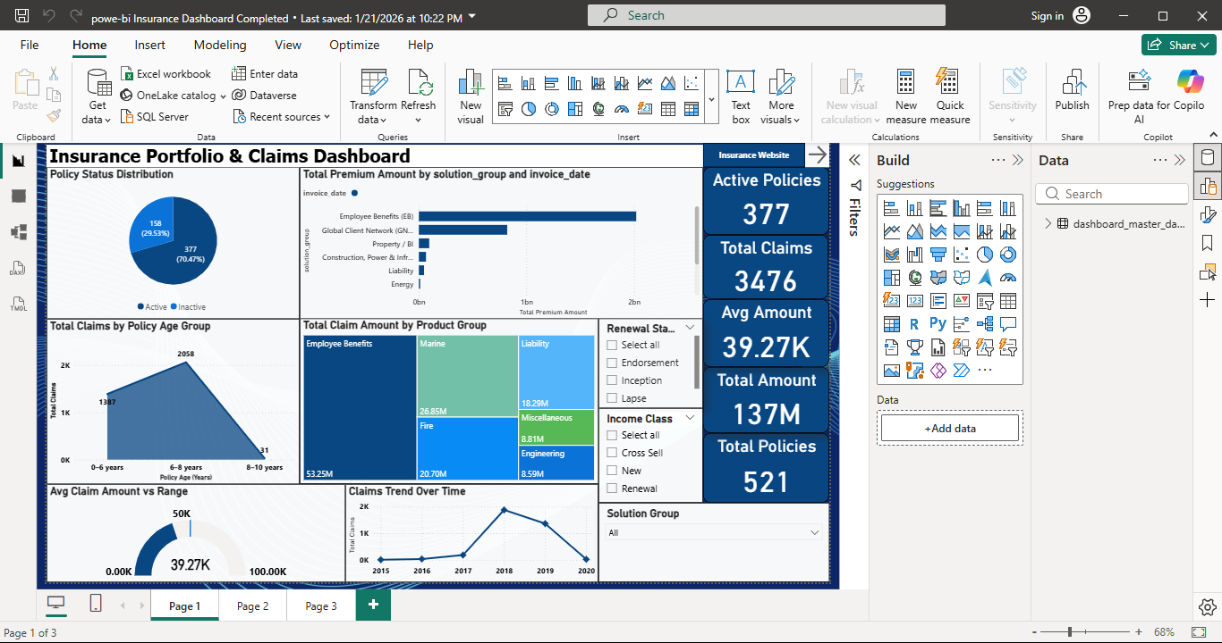
POWER BI DASHBOARD OVERVIEW:
Portfolio & Claims Overview:- This Power BI dashboard presents a consolidated view of insurance portfolio and claims performance. It highlights key KPIs, policy status distribution, and premium trends.
Interactive Analysis:- Slicers such as income class, renewal status, and solution group enable dynamic filtering. This allows users to analyze performance from multiple perspectives.

Slide 12
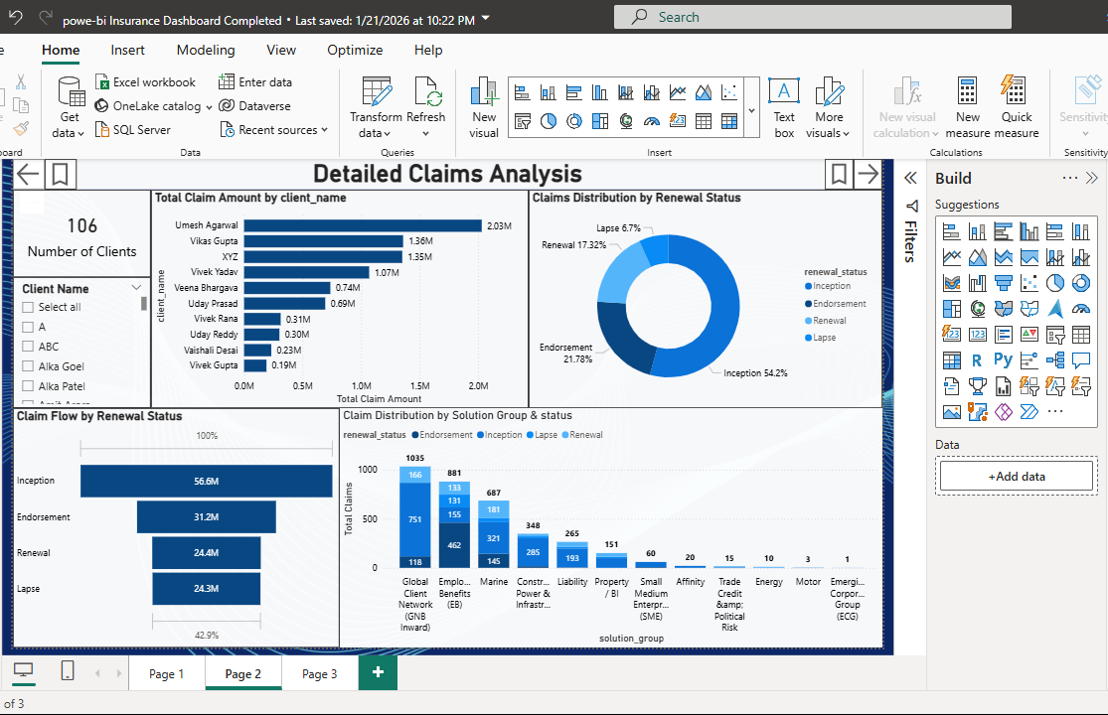
DETAILED CLAIMS ANALYSIS:
Detailed Claims Breakdown This dashboard focuses on detailed claims analysis by client, solution group, and renewal status. It helps identify claim-heavy segments and high-value clients.
Trend & Distribution Analysis Claims distribution and trends over time are visualized clearly. This supports risk assessment and operational decision-making.

Slide 13
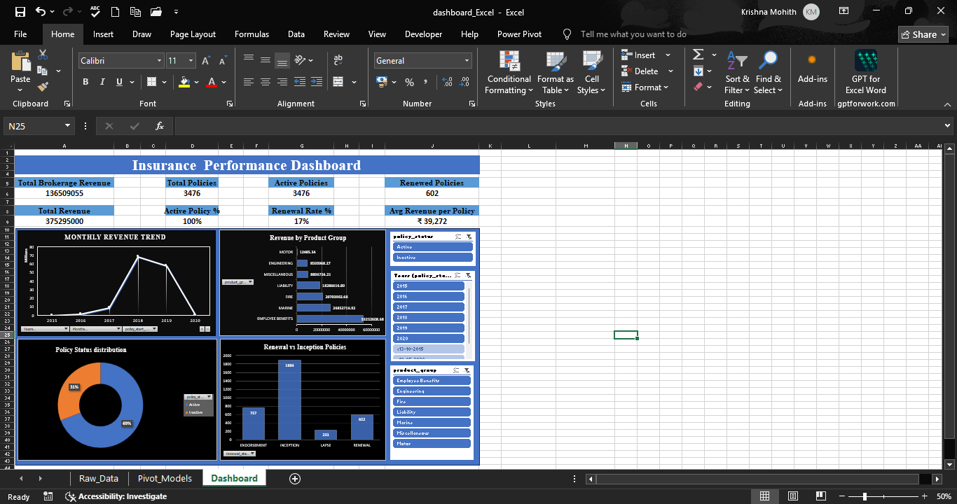
EXCEL ANALYSIS & DATA VALIDATION:
Data Validation Excel was used to validate cleaned and merged insurance data. It ensures consistency between raw data and dashboard results.
Detailed Drill-Down Excel provides record-level visibility for policies and claims. This supports detailed verification and cross-checking of KPIs.
Supporting Analysis Pivot tables and summaries were used for quick calculations. This helped validate trends before visualizing them in BI tools

Slide 14
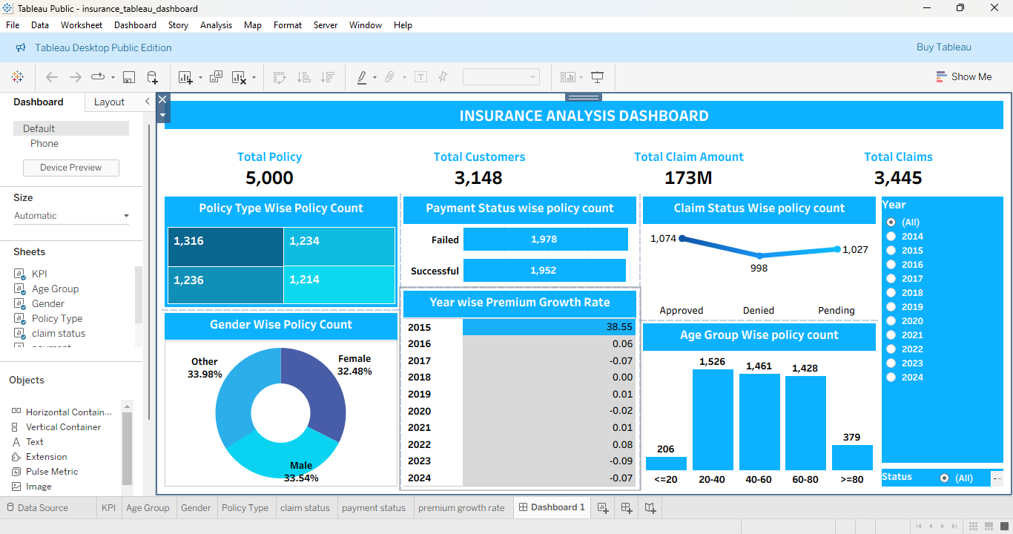
TABLEAU DASHBOARD OVERVIEW:
Visual Exploration:- The Tableau dashboard focuses on visual exploration of claims and portfolio data. It highlights patterns and distributions across solution groups and policy status.
Comparative Analysis:- Tableau enables easy comparison across categories and time periods. This helps identify high-risk and high-impact segments.
Insight Discovery:- Interactive visuals support faster insight discovery. They complement Power BI by offering an alternate analytical view.

Slide 15
SQL – Data Extraction & Analysis:
SQL Usage in the Project:- SQL was used to query the cleaned and merged insurance master dataset. It enabled structured extraction of portfolio and claims information.
Analytical Operations:- SQL queries were written to filter data, calculate aggregations, and group records. This helped derive KPIs such as total policies, total claims, and premium amounts.
Data Accuracy & Validation:- SQL ensured consistency between the source data and BI dashboards. The query results were cross-validated with Excel and Power BI outputs.

Slide 16
CHALLENGES, KEY TAKEAWAYS , INSIGHTS & Conclusion:
Challenges Faced : - Handling multiple insurance datasets required careful cleaning and standardization. Merging data from different sources while maintaining accuracy was challenging.
Key Takeaways:- Data quality plays a critical role in generating reliable insights. Clear KPIs and simple dashboards improve decision-making.
Key Insights:- Claims are concentrated in specific solution groups and policy statuses. Active and renewed policies contribute most to portfolio value
Business Observations:- Certain policy age groups and products show higher claim amounts. This indicates areas requiring closer risk monitoring.
Conclusion:- The project successfully applied data analytics techniques to insurance portfolio and claims data. It demonstrated how raw data can be transformed into actionable business insights

Slide 17
Thank You
Thank you for your time and attention.

